Slide 1
Data Link Layer
Dr. Muazzam A. Khan

Slide 2
Objectives
Explain the role of Data Link layer protocols in data transmission.
Describe the different types of media access control methods.
Identify several common logical network topologies and describe how the logical topology determines the media access control method for that network.
Explain the purpose of encapsulating packets into frames to facilitate media access.
Describe the Layer 2 frame structure
Explain the role of key frame header and trailer fields

Slide 3
Presentation CCN
Topic Advance topic in Networks 01
Evolve (Problem?) Solution, Advance Version
1. Introduction 1.1. Applications of Tech 02 With Diagram
2. History 2026, 2025, 2024 etc Pro and Cons 04-05
(8-10 Tech) 02/03 Tech
3. Current Status of Technology 01
4. Existing Problems (Critically analyze) 01
5. Future of Technology. 01
6. Your Recommendations 01
7. References 01-02
A. Authors, Title, Where, When it was published?

Slide 4
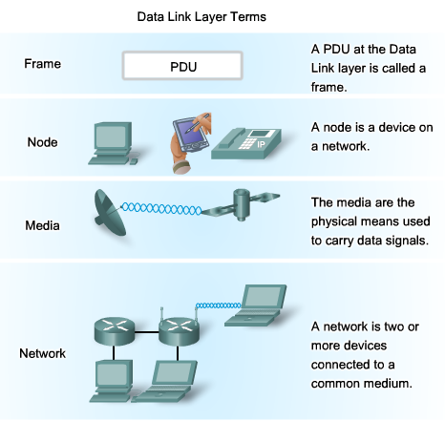
Data Link Layer Terms

Slide 5
Data Link Layer – Accessing the Media
For network layer packets to be transferred from source host to destination host, they must traverse different physical networks.
These physical networks can consist of different types of physical media such as copper wires, microwaves, optical fibers, and satellite links.
Data link layer prepares network layer packets for transmission and controls access to the physical media.

Slide 6
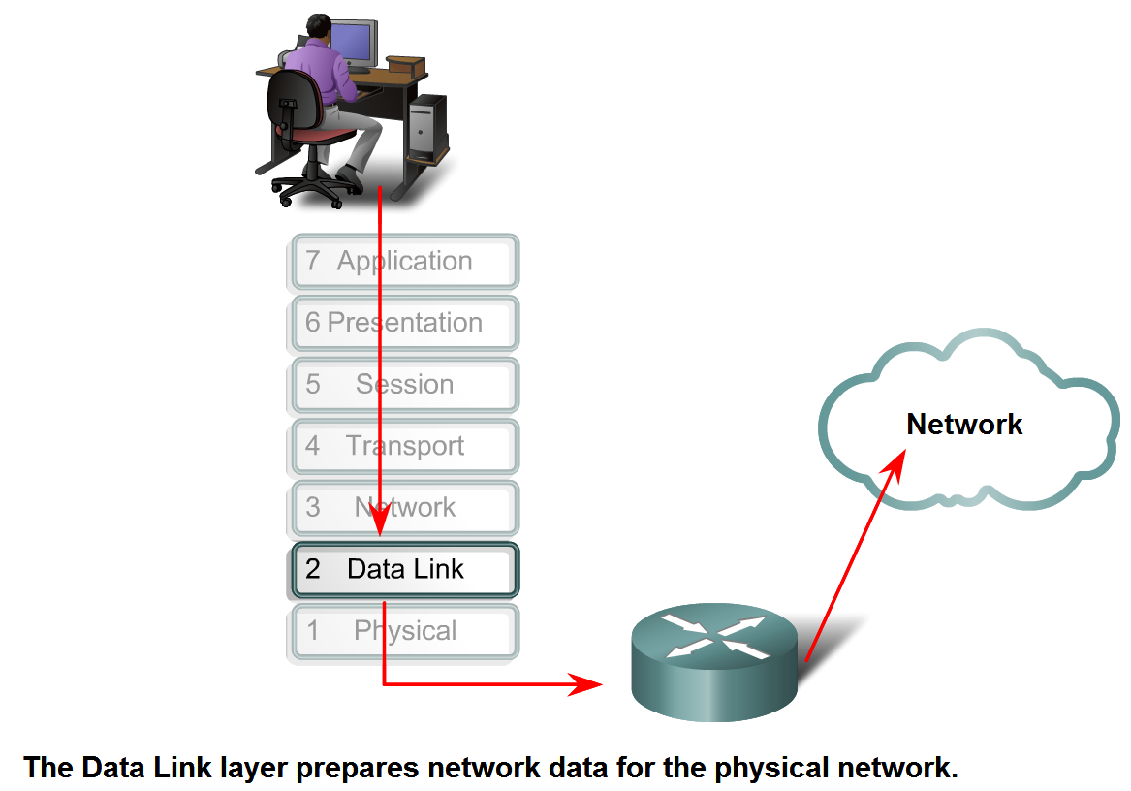
Data Link Layer – Accessing the Media

Slide 7
Data Link Layer – Accessing the Media
In any given exchange of network layer packets, there can be numerous data link layer and media transitions.
At each hop along the path, an intermediary device, processes the frame as follows:
1. Accepting the frame from a medium
2. Decapsulating the frame into a packet
3. Constructing a new frame appropriate for the next media
4. Forwarding the packet inside the new frame across the next segment of the physical network

Slide 8
Data Link Layer Services
Two basic services:
Allows the upper layers to access the media using techniques such as framing
Controls how data is placed onto the media and is received from the media using techniques such as media access control and error detection

Slide 9
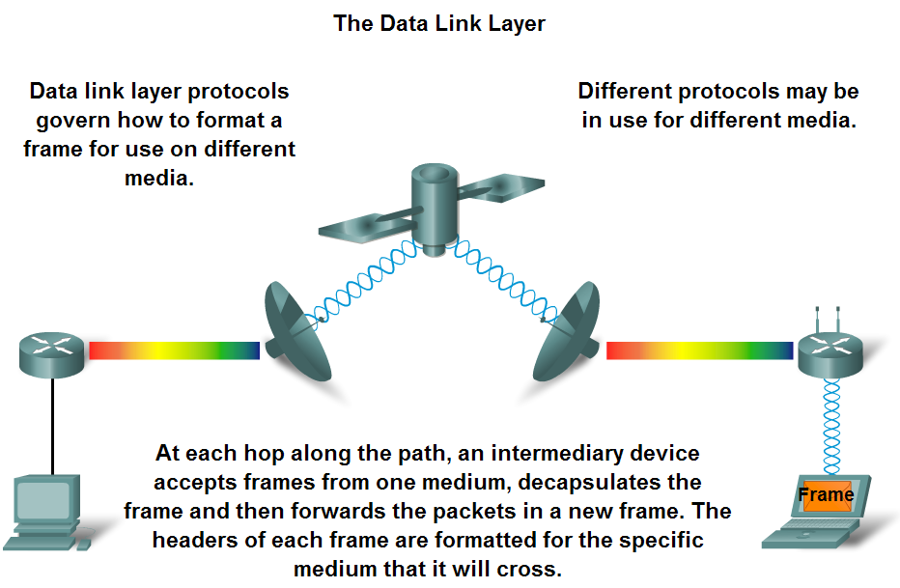
Data Link Layer Protocols
Data Link layer protocols are required to control access to the media

Slide 10
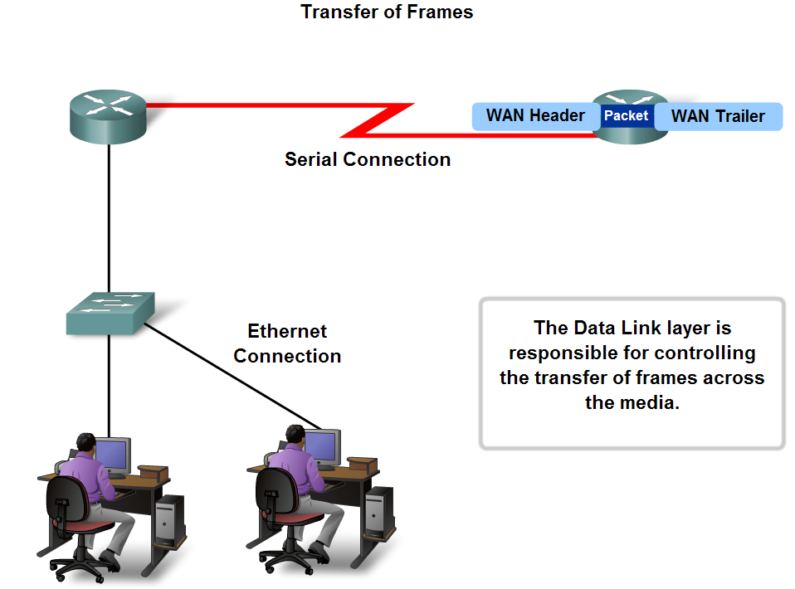
Media Access Control
The technique used for getting the frame on and off media is called the media access control method.
The MAC methods define the processes by which network devices can access the network media and transmit frames in diverse network environments

Slide 11
The Data-Link PDU - Frames
The Data Link layer prepares a frame for transfer across the local media by encapsulating it with a header and a trailer.
The Data Link layer frame includes:
  Data - The packet from the Network layer
  Header - Contains control information, such as addressing, and is located at the beginning of the PDU
  Trailer - Contains control information added to the end of the PDU (Protocol Data Unit)

Slide 12
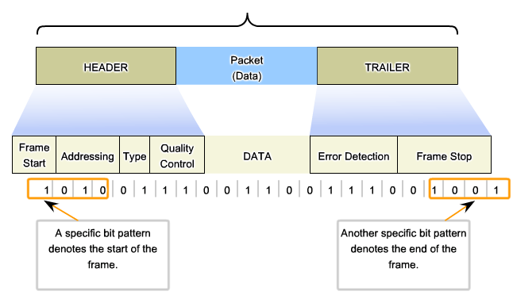
Formatting Data for Transmission
More on frame fields later…

Slide 13
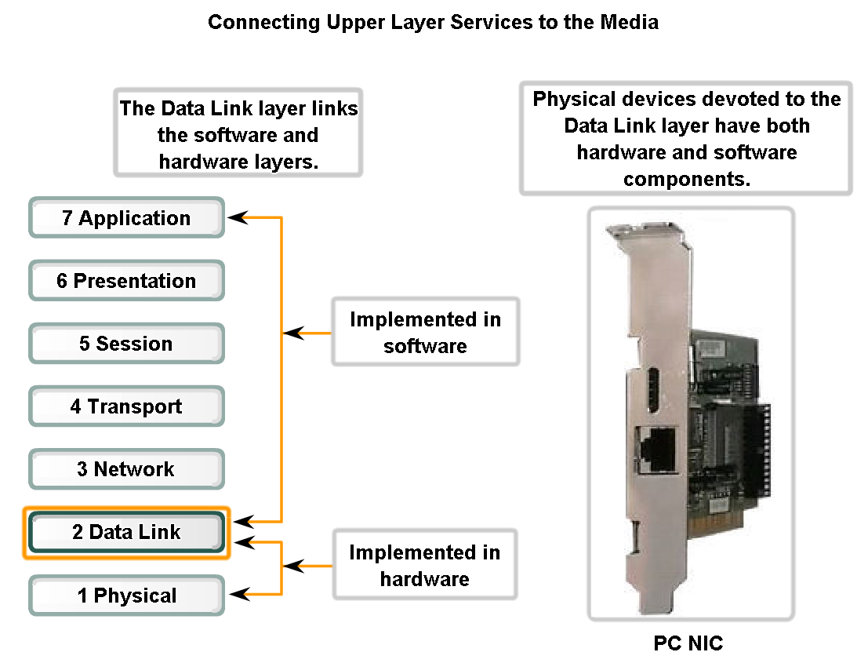
Data Link Layer – Hardware & Software Layers
An adapter is used to make the connection to the network
The adapter manages the framing and media access method.
The NIC (Network Interface Card) connects the PC to the media

Slide 14
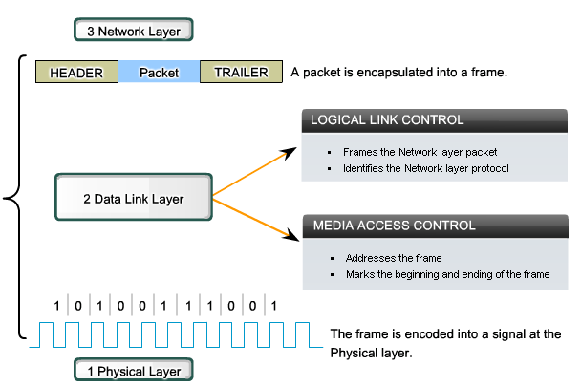
Data Link Sublayers- LLC & MAC

Slide 15
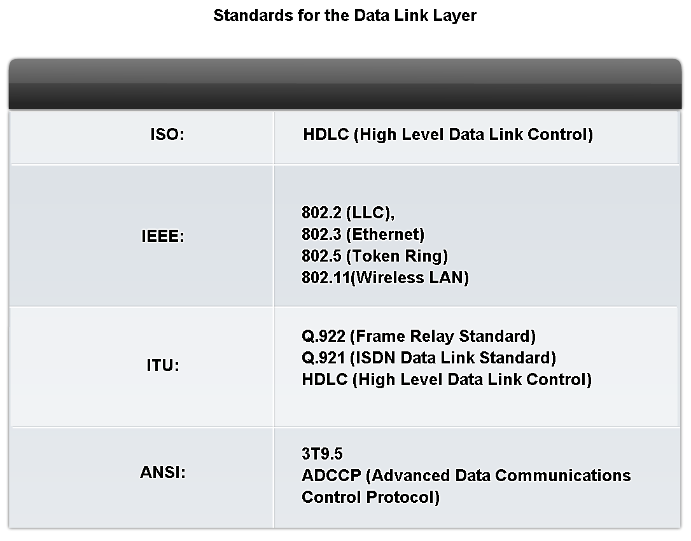
Data Link Layer – Protocols & Standards
Protocols and standards used by the Data Link layer…
International Organization for Standardization
Institute of Electrical and Electronics Engineers
International Telecommunication Union
American National
Standards Institute

Slide 16
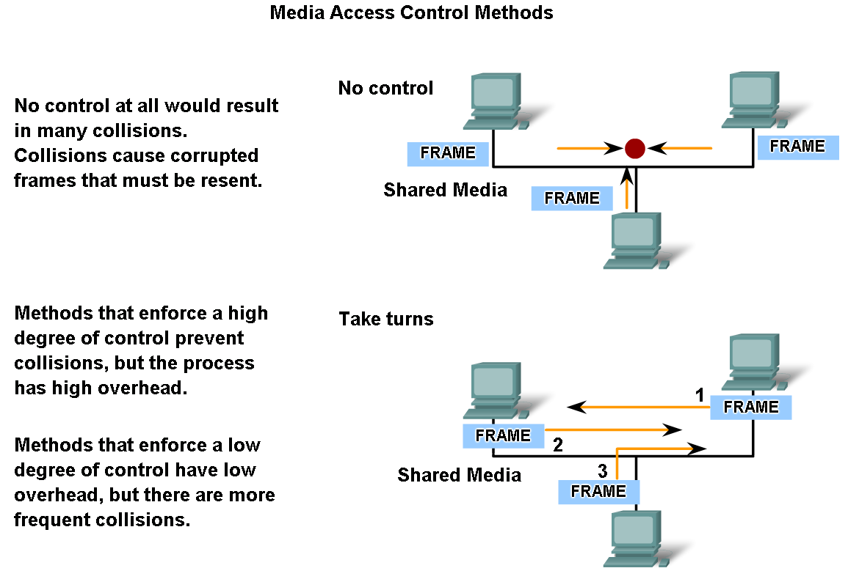
Media Access Control Techniques
The method of MAC used depends on
  Media sharing: If and how the nodes share the media
  Topology: How the connection between the nodes appears to the data link layer

Slide 17
MAC for Shared Media
Medium with multiple nodes.
At any one time, there can be a number of devices attempting to send and receive data using the network media.
The two basic MAC methods for shared media are as follows:
  ■ Controlled: Each node has its own time to use the medium.
  ■ Contention-based: All nodes compete for the use of the medium

Slide 18
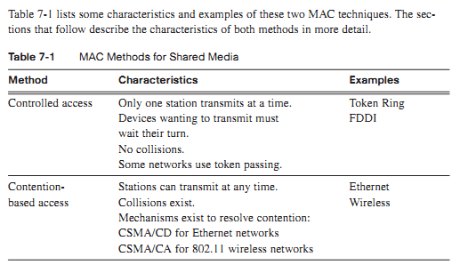
MAC for Shared Media

Slide 19
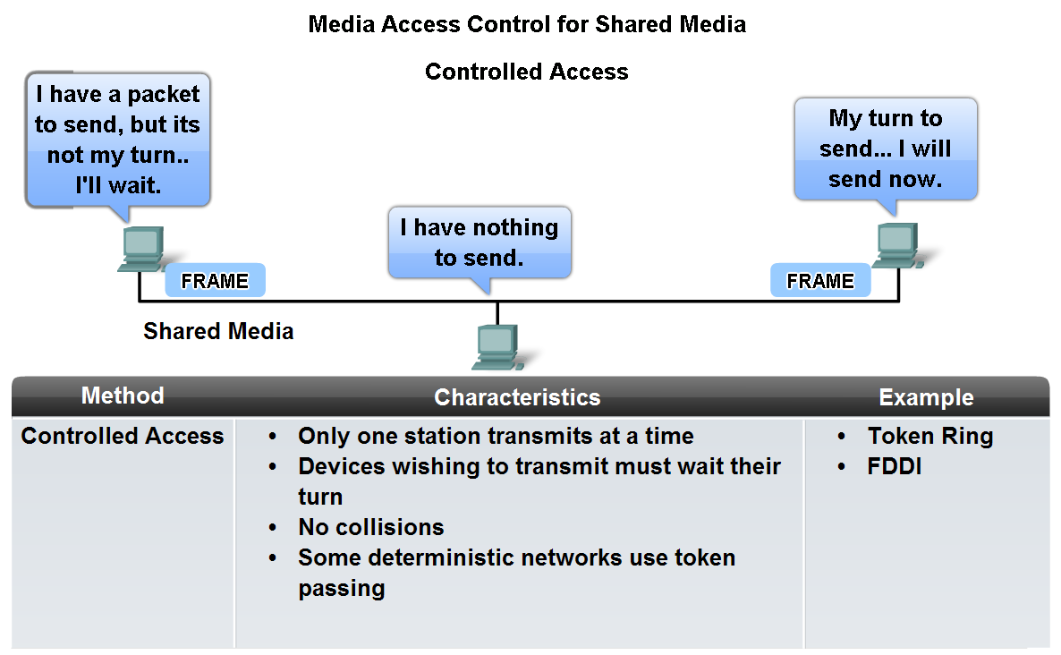
MAC for Shared Media Environment
AKA deterministic

Slide 20
MAC for Shared Media
Contention-Based Access for Shared Media
  Allow any device to try to access the medium whenever it has data to send = nondeterministic.
  To prevent complete chaos on the media, these methods use a carrier sense multiple access (CSMA) process to first detect whether the media is carrying a signal.
  When the device attempting to transmit sees that the media is busy, it will wait and try again after a short time period.
  If no carrier signal is detected, the device transmits its data..

Slide 21
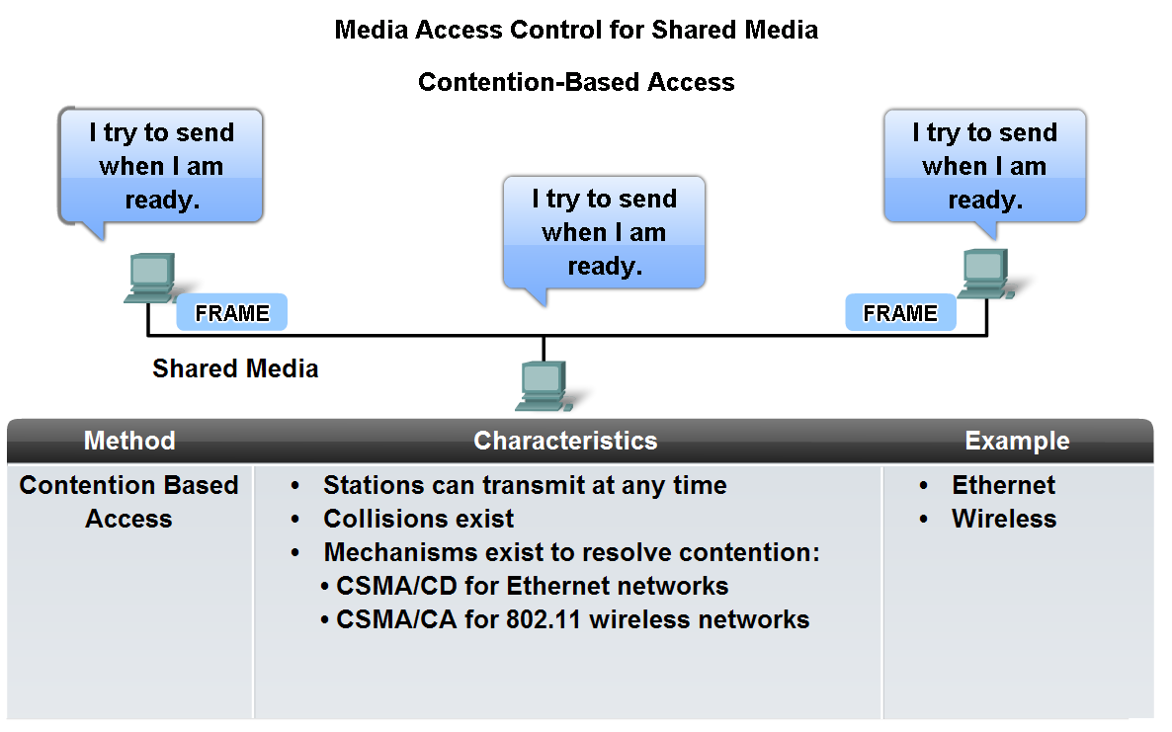
Contention-based Access in a Shared Media Environment
Non Deterministic

Slide 22
MAC for Shared Media
Contention-Based Access for Shared Media
  It is possible that the CSMA process will fail and two devices will transmit at the same time.
  This is called a collision. If a collision occurs, the data sent by both devices will be corrupted and will need to be re-sent.
  CSMA is usually implemented in conjunction with a method for resolving the media contention. The two commonly used methods are
    ■ CSMA/collision detect (CSMA/CD)
    ■ CSMA/collision avoid (CSMA/CA)

Slide 23
Contention-based Access in a Shared Media Environment
Two CSMA methods:
  CSMA/Collision Detection (CSMA/CD) –
  The device monitors the media for the presence of a data signal.
  If no signal is present, the device transmits (could result in collisions with other data)
  CSMA/Collision Avoidance (CSMA/CA) –
  The device examines the media for the presence of a data signal.
  If the media is free, the device sends a notification across the media of its intent to use it. The device then sends the data.
AKA first come, first serve and non-deterministic

Slide 24
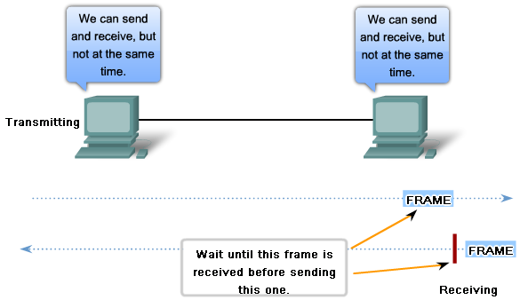
Media Access Control For Non-Shared Media
In point-to-point connections, the Data Link layer has to determine whether the communication is half-duplex or full-duplex.
Half Duplex – a station cannot transmit and receive simultaneously

Slide 25
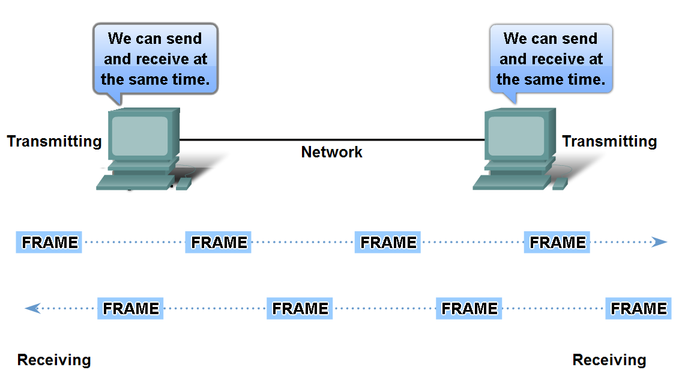
Media Access Control For Non-Shared Media
Full Duplex – a station can transmit and receive simultaneously

Slide 26
The Topology of a Network
The topology of a network is the arrangement/relationship of the network devices and the interconnections between them
Network topologies can be viewed at the physical level and the logical level.
Physical Topology -the arrangement of the nodes and the physical connections between them.
Logical Topology - the way a network transfers frames from one node to the next. The logical signal paths defined by Data Link layer protocols. The logical topology influences the type of network framing and media access control used.
NOTE: The physical or cabled topology of a network will most likely not be the same as the logical topology.

Slide 27
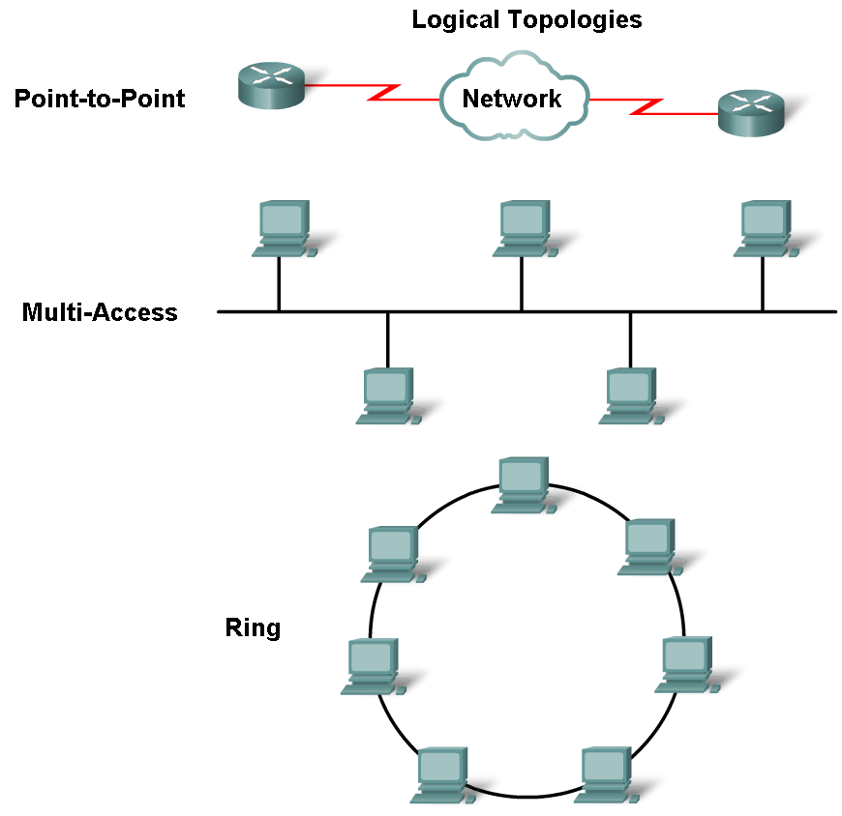
A Look at Logical Topologies

Slide 28
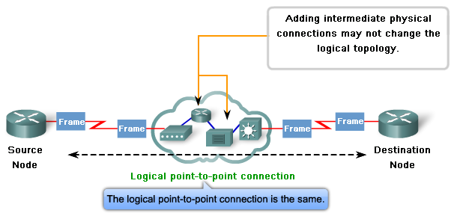
Logical Point-to-Point Topology
The logical connection between nodes is sometimes referred to as a virtual circuit

Slide 29
Logical Multi-Access Topology
Enables a number of nodes to communicate by using the same shared media (AKA logical bus topology)
Data from only one node can be placed on the medium at a time
Every node sees all the frames that are on the medium, but only the node to which the frame is addressed processes the contents of the frame
Requires a method to regulate the transmission of data and thereby reduce collisions between different signals
Media access control methods used by logical multi-access topologies are:
  CSMA/CD
  CSMA/CA
  Token Passing

Slide 30
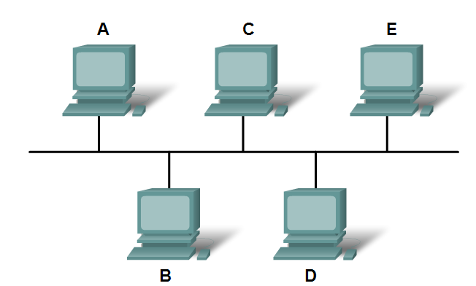
Logical Multi-Access Topology
A frame sent from source A to destination D will be seen by all devices, including B, C, D, & E.
Only D, the destination, will process the frame.

Slide 31
Logical Ring Topology
In a logical ring, all nodes around the ring between the source and destination node examine the frame
  If the frame is not addressed to the node, the node passes the frame to the next node
This allows a ring to use a media access control technique called token passing
In token passing, when there is no data being transmitted, a signal (known as a token) may be placed on the media and a node can only place a data frame on the media when it has the token.

Slide 32
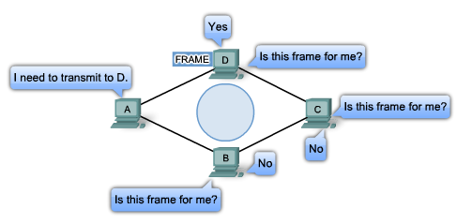
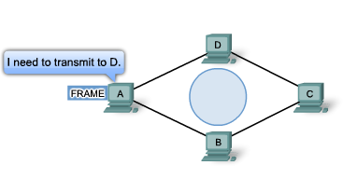
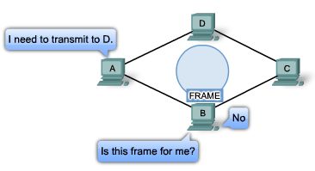
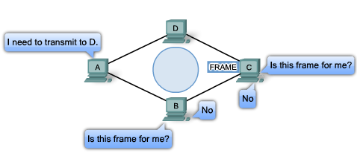
Logical Ring Topology
Node A can transmit once it has the electronic token

Slide 33
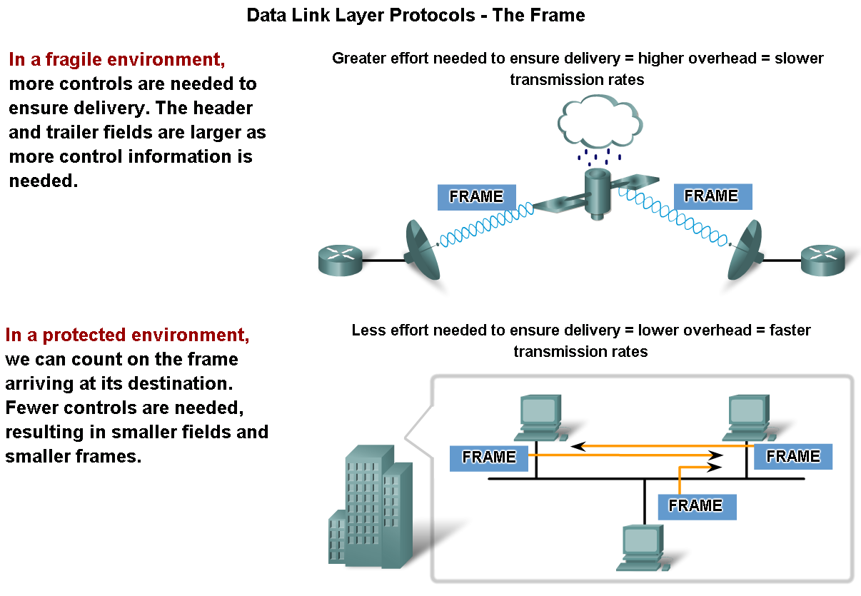
Addressing and Framing Data
Packets are encapsulated into frames at the Data Link Layer to facilitate the entry and exit of data on media

Slide 34
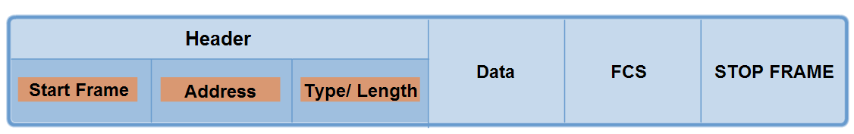
Generic Frame Format
Question: What is contained within this field?
Answer:

Slide 35
Typical Frame Header Fields
Start Frame field - Indicates the beginning of the frame
Source and Destination address fields
– Indicates the source and destination nodes on the media
Priority/Quality of Service field
- Indicates a particular type of communication service for processing
Type field - Indicates the upper layer service contained in the frame
Flow control field - Used to start and stop traffic over the media
Congestion control field - Indicates congestion in the media

Slide 36
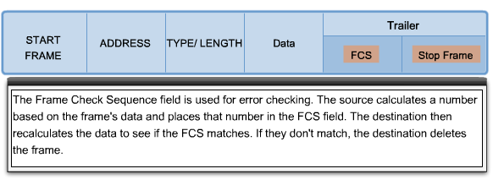
The Role of the Frame Trailer- FCS Field
The calculated value placed in the FCS field is called the CRC (cyclic redundancy check)

Slide 37
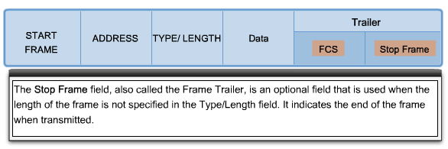
The Role of the Frame Trailer – Stop Frame

Slide 38
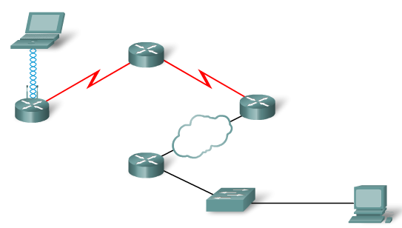
Layer 2 Protocols Covered
Ethernet
Point-to-Point Protocol (PPP)
High-Level Data Link Control (HDLC)
Frame Relay
Asynchronous Transfer Mode (ATM)

Slide 39
Selecting a Layer 2 Protocol
When implementing a Layer 2 protocol in a network, the following factors should be considered:
  Geographic scope of the network
  The physical layer implementation
  The number of hosts to be connected
Note: Layer 2 protocols are independent of the upper layer protocols used

Slide 40
Ethernet Protocol for LANs
Ethernet is a family of networking technologies IEEE 802.2 and 802.3 standards
Ethernet is the most widely used LAN technology and supports data bandwidths of 10, 100, 1000, or 10,000 Mbps.
Ethernet standards define both the Layer 2 protocols and the Layer 1 technologies
Ethernet provides unacknowledged connectionless service over a shared media using CSMA/CD as the media access methods.
An Ethernet MAC address is 48 bits and is generally represented in hexadecimal format.

Slide 41
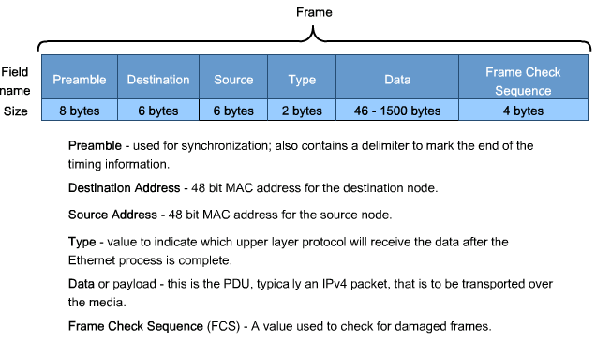
The Ethernet II Frame

Slide 42
Point-to-Point Protocol (PPP) for WANs
Point-to-Point Protocol (PPP) is a WAN protocol used to deliver frames between two nodes
PPP remains the protocol of choice to implement many serial WANs
PPP can be used on various physical media, including twisted pair, fiber optic lines, and satellite transmission.
PPP also allows the two nodes to negotiate options within the PPP session including:
  authentication, compression, and multilink (the use of multiple physical connections)

Slide 43
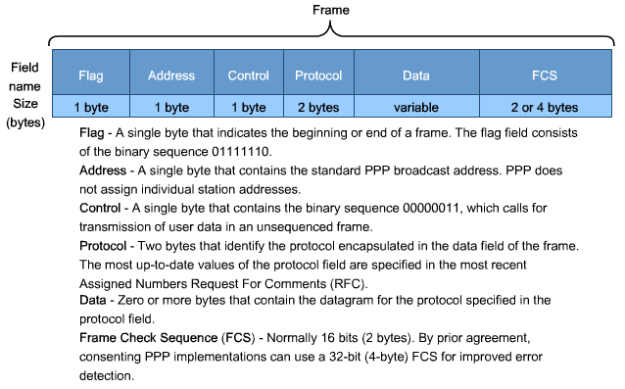
PPP Frame
WHY?

Slide 44
Wireless Protocol for LANs
The Standard IEEE 802.11 is commonly referred to as Wi-Fi
Uses a 48-bit addressing scheme as other 802 LANs, however there are many differences at the MAC sublayer and Physical layer
A wireless environment requires special considerations since external factors may interfere with data transfer and it is difficult to control access
802.11 networks use a contention-based system with the Carrier Sense Multiple Access/Collision Avoidance (CSMA/CA) media access process.
CSMA/CA specifies a random backoff procedure for all nodes that are waiting to transmit
802.11 networks also use Data Link acknowledgements to confirm that a frame is received successfully
If the sending station does not detect the acknowledgement frame, the data frame is retransmitted.

Slide 45
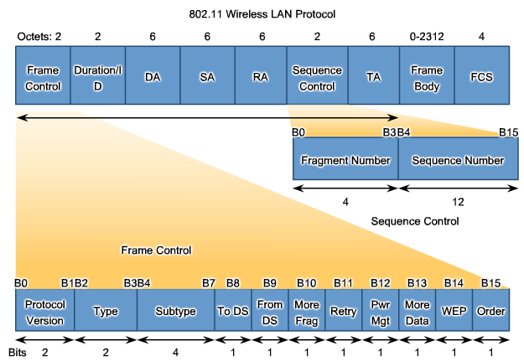
802.11 Wireless Frame

Slide 46
802.11 Wireless Frame Fields
Protocol Version field - Version of 802.11 frame in use
Type and Subtype fields - Identifies one of three functions and sub functions of the frame: control, data, and management
To DS field - Set to 1 in data frames destined for the distribution system (devices in the wireless structure)
From DS field - Set to 1 in data frames exiting the distribution system
More Fragments field - Set to 1 for frames that have another fragment
Retry field - Set to 1 if the frame is a retransmission of an earlier frame
Power Management field - Set to 1 to indicate that a node will be in power-save mode
More Data field - Set to 1 to indicate to a node in power-save mode that more frames are buffered for that node
Wired Equivalent Privacy (WEP) field - Set to 1 if the frame contains WEP encrypted information for security

Slide 47
802.11 Wireless Frame Fields Cont’d…
Order field - Set to 1 in a data type frame that uses Strictly Ordered service class (does not need reordering)
Duration/ID field - Depending on the type of frame, represents either the time, in microseconds, required to transmit the frame or an association identity (AID) for the station that transmitted the frame
Destination Address (DA) field - MAC address of the final destination node in the network
Source Address (SA) field - MAC address of the node the initiated the frame
Receiver Address (RA) field - MAC address that identifies the wireless device that is the immediate recipient of the frame
Transmitter Address (TA) field - MAC address that identifies the wireless device that transmitted the frame
Sequence Number field - Indicates the sequence number assigned to the frame; retransmitted frames are identified by duplicate sequence numbers
Fragment Number field - Indicates the number for each fragment of a frame
Frame Body field - Contains the information being transported; for data frames, typically an IP packet
FCS field - Contains a 32-bit cyclic redundancy check (CRC) of the frame

